Slide 1
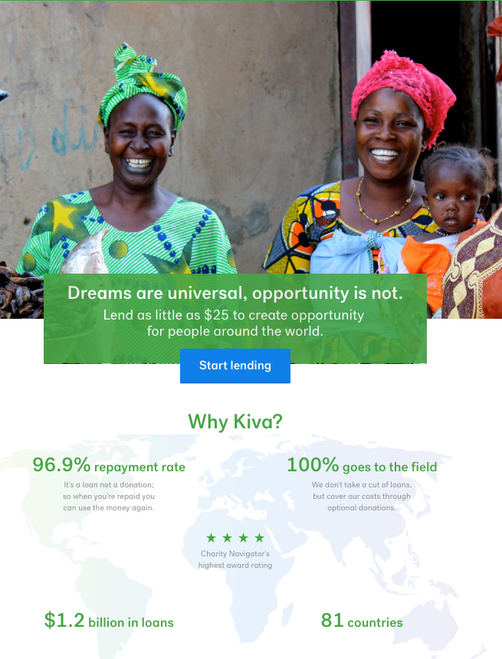
Machine Learning with Kiva Microloans Data
Focus: Philanthropic Financing
Founded in SF in 2005, Kiva uses their online, crowd-funding platform to facilitate flexible micro-lending in more than 80 countries for those who are otherwise financially excluded and/or can't access other fair or affordable credit sources.
The Data:
671,000+ loan data points from the past 4 years, largely cleaned
93% success rate ('funded_amount' >=100% 'loan_amount’)
(Likely) Influencing Factors:
Borrowers and their requests are vetted by Kiva's regional partners before the campaign is posted & Kiva's banking/institutional partnerships rely on their continuing to see fully-funded campaigns.
Site users choose which campaigns they'll support, thus some campaigns don't succeed within allowed 30-days

Slide 2
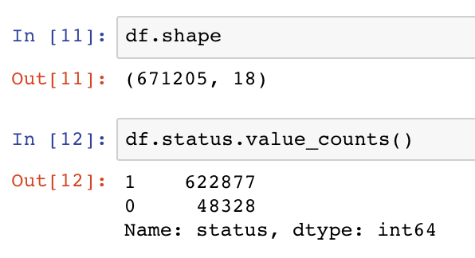
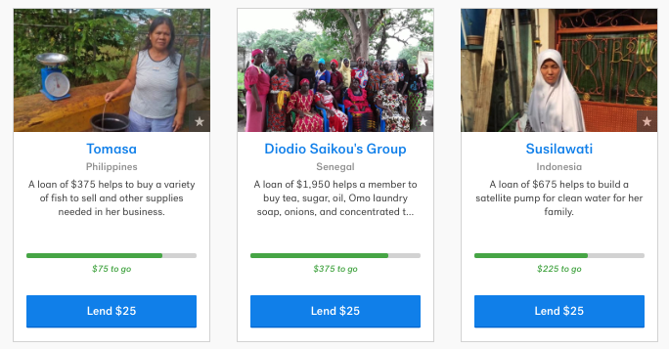
The Data: Categorical & Imbalanced
Learning Opportunity:
As with detecting fraud, filtering spam, or screening for rare diseases, imbalanced data requires alternative training and evaluative approaches. Normal accuracy measuring is rendered unreliable due to high frequency of single occurrence.
Newb: "WOW, a 0.93 p-value! and I didn't even DO anything!!” (o_o) (-__-) Just…no.
Our Objectives:
To predict the probability of successful funding for a real-time generated Kiva borrower profile.
To learn the most we could about all aspect of building and refining ML models

Slide 3
Feature Engineering
One-Hot Encoding w/ Categorical Data = Lots of Columns & 0’s
18 features in original >>> 7 for final set >>> 885 unique feats.
Features in Demo:
Loan_amount
Term_in_months
Repayment_interval (monthly, bullet(all at once), interval(other))
Country
Gender (M/F, others dropped)
Activity *(ex. 'Sector': 'Food', 'Activity': 'Milk Sales’)*
*not included* Sector
Models :
Decision Tree
Random Forest
KNN
Deep Learning
Other Models

Slide 4
Models and Approaches
Modeling Dummies vs. Label Coding & Coefficients Replacement
Why Replace?
- Imbalanced data results in high p-value but w/ low significance
- Instead, need to provide feature weights for accuracy
The Bare Bones How-To:
1. Create X,Y values for labels to feed into Logistic Regression model
2. Calculate and store coefficient for each category member
3. Replace category items in dataset with their respective coefficient values
In non-demo models, categories 'Activity', 'Sector', & 'Country' were all coded and replaced.

Slide 5
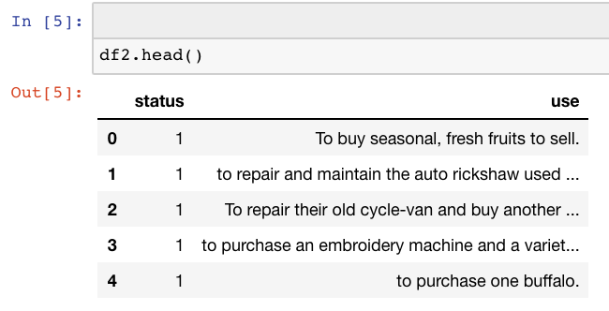
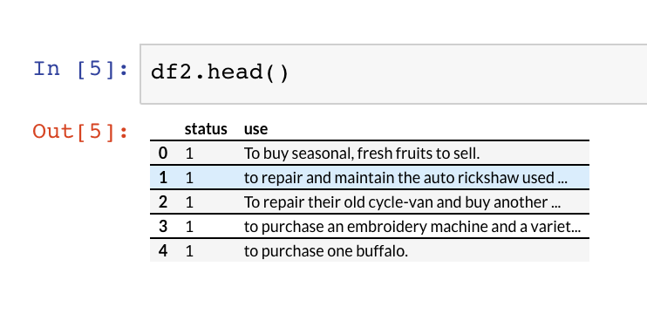
Diving Into the Descriptions w/ NLP:

Slide 6
Diving Into the Descriptions w/ NLP:
Grab use description and status to explore whether description content or length affected outcome

Slide 7
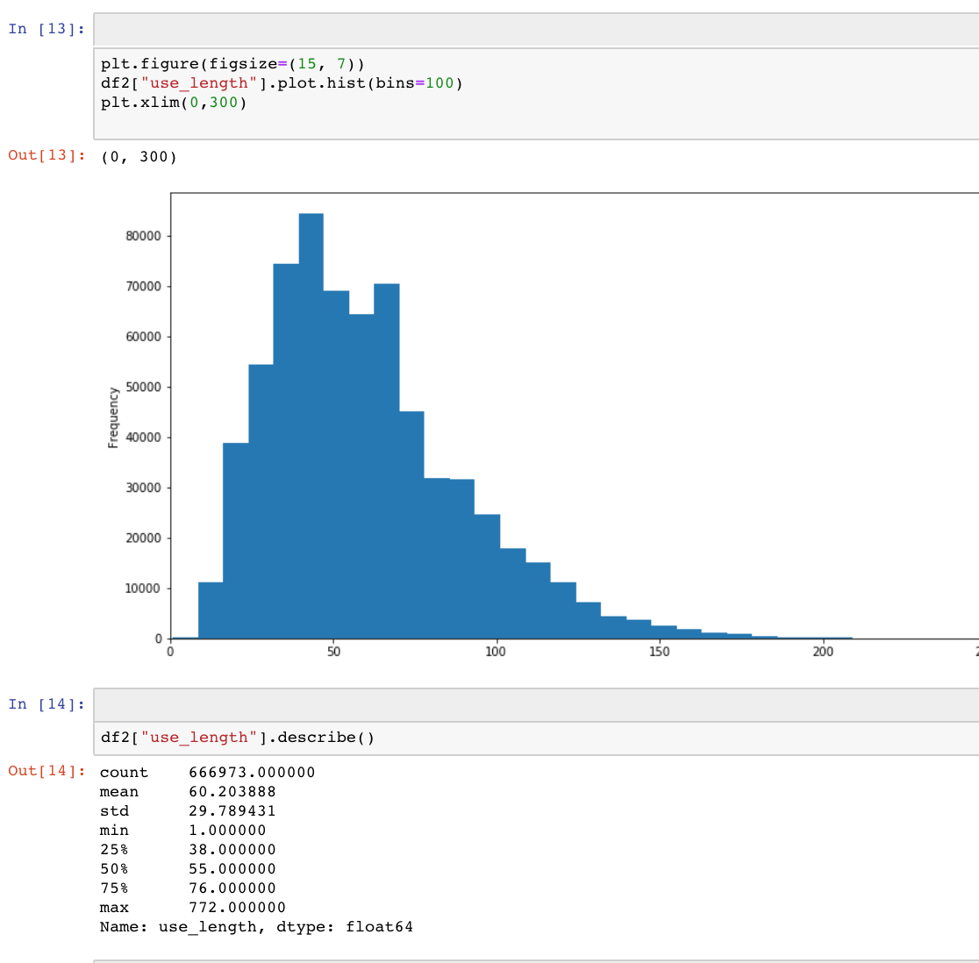
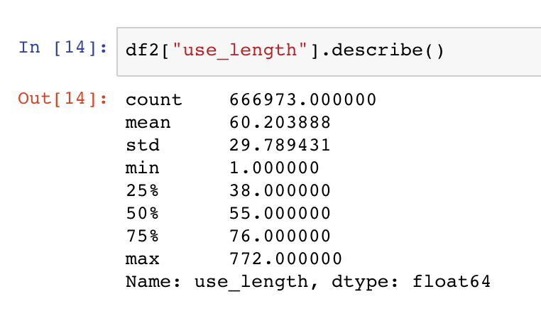
Diving Into the Descriptions w/ NLP:
Length ranged from 1 to 772 characters
Avg. was ~60 characters (less than allowed Tweet)
Surprising amount had no description/white space

Slide 8
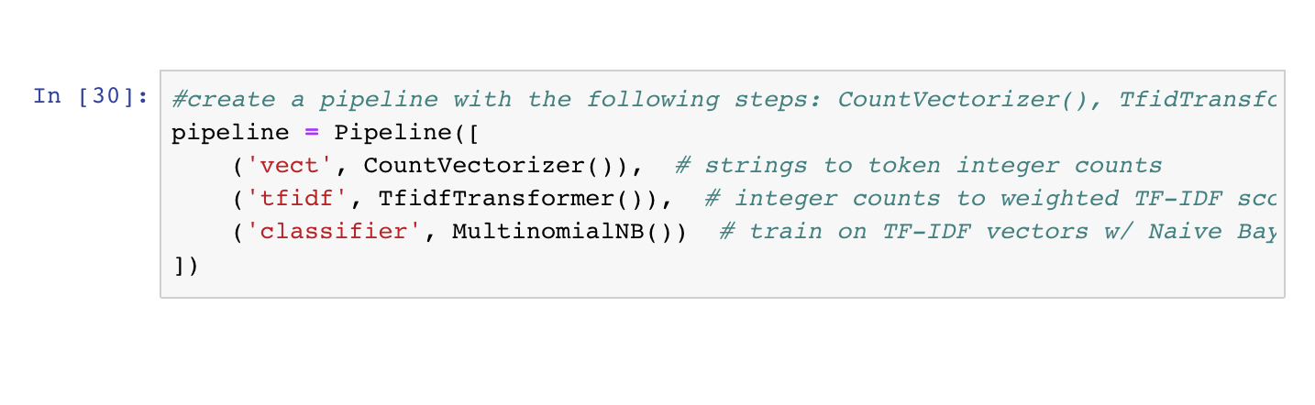
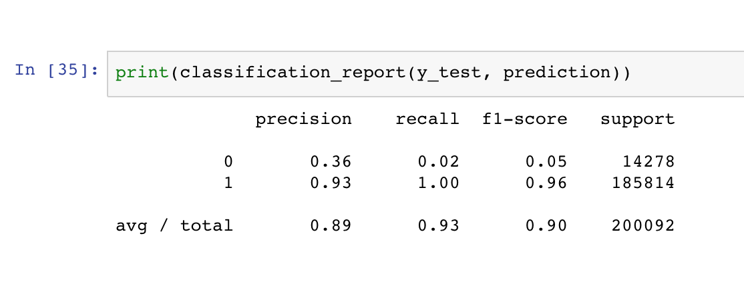
Diving Into the Descriptions w/ NLP:

Slide 9
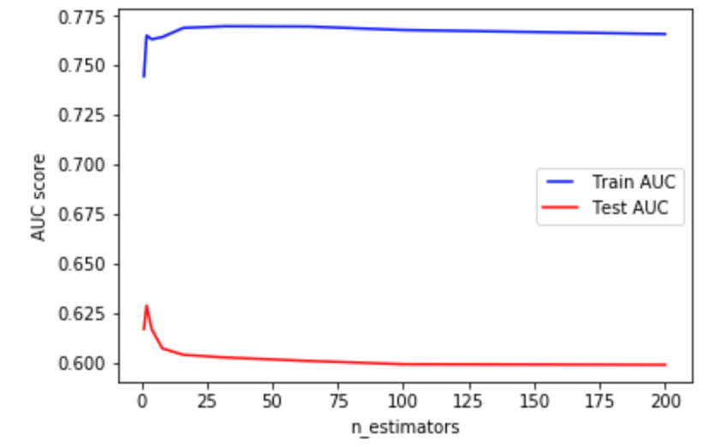
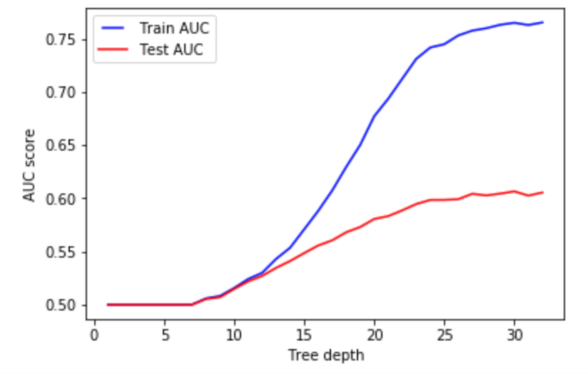
Hyper Parameter Tuning
N-estimators | max_depth
N_estimators represents the number of trees in the forest. Usually the higher the number of trees the better to learn the data. However, adding a lot of trees can slow down the training process considerably, therefore we do a parameter search to find the sweet spot | max_depth represents the depth of each tree in the forest. The deeper the tree, the more splits it has and it captures more information about the data. We fit each decision tree with depths ranging from 1 to 32 and plot the training and test errors.
n_estimators = [1, 2, 4, 8, 16, 32, 64, 100, 200] | max_depths = np.linspace(1, 32, 32, endpoint=True)

Slide 10
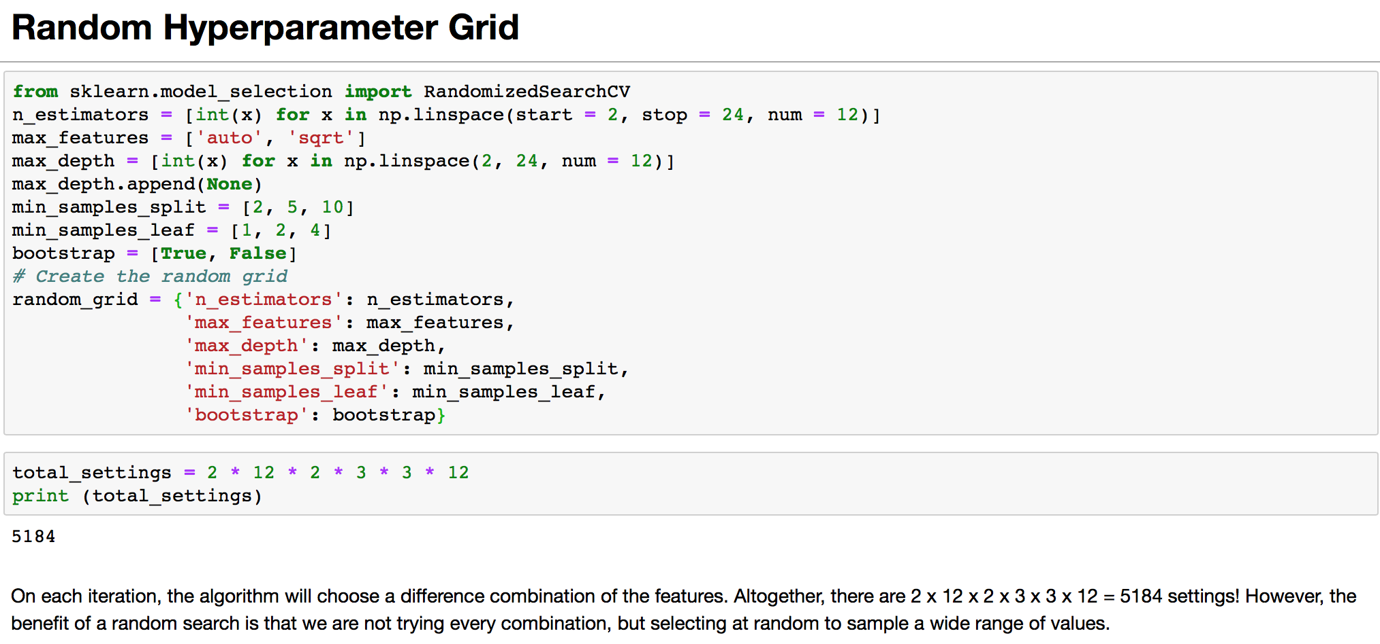

Slide 11
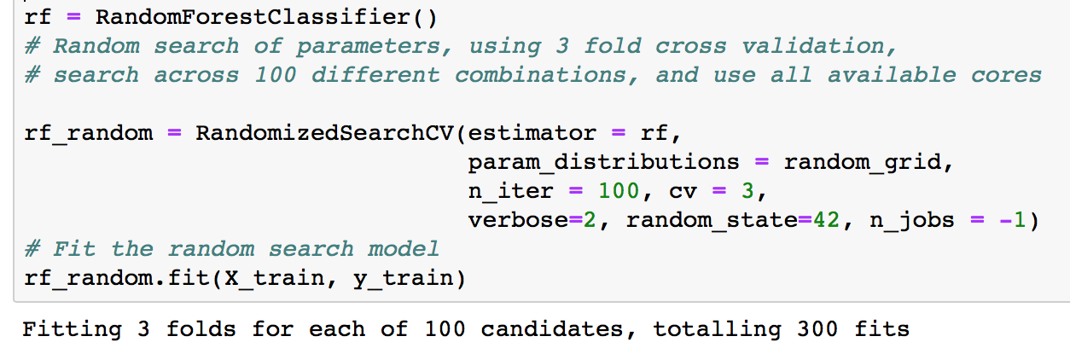
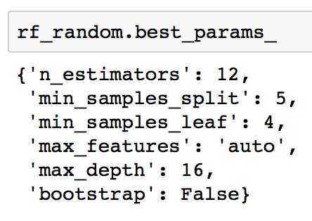
Random Search Training
from sklearn.model_selection import RandomizedSearchCV

Slide 12


Slide 13
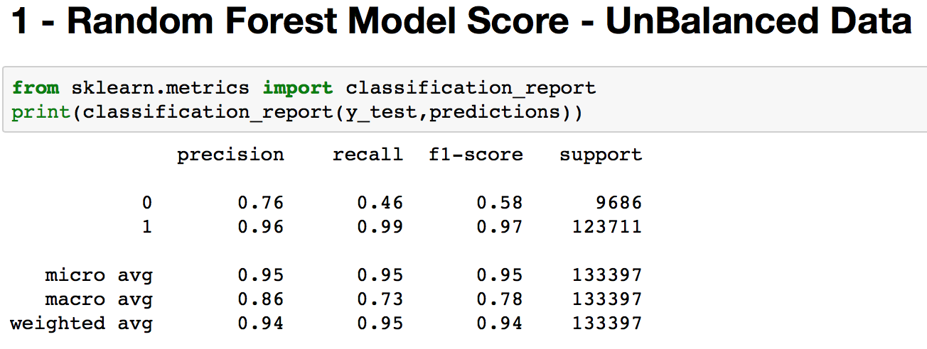
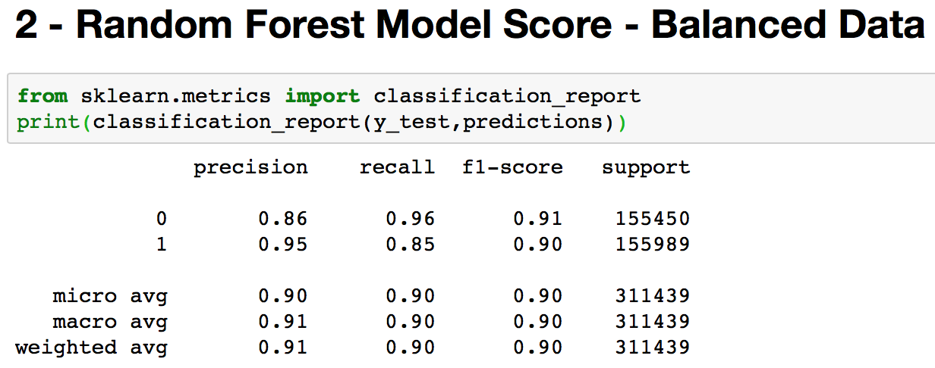

Slide 14
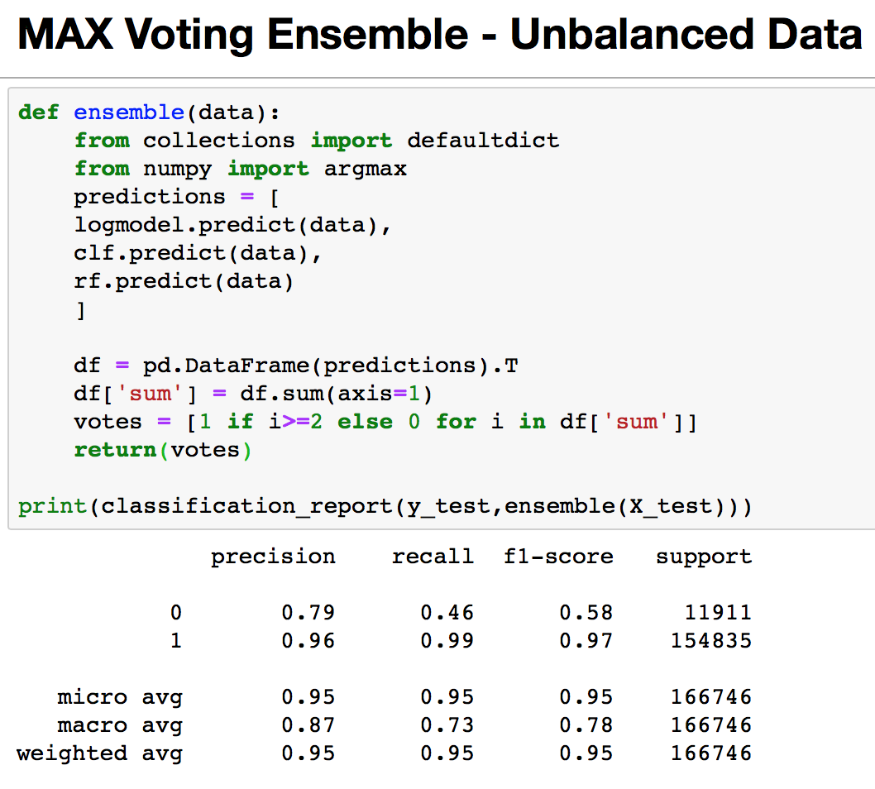
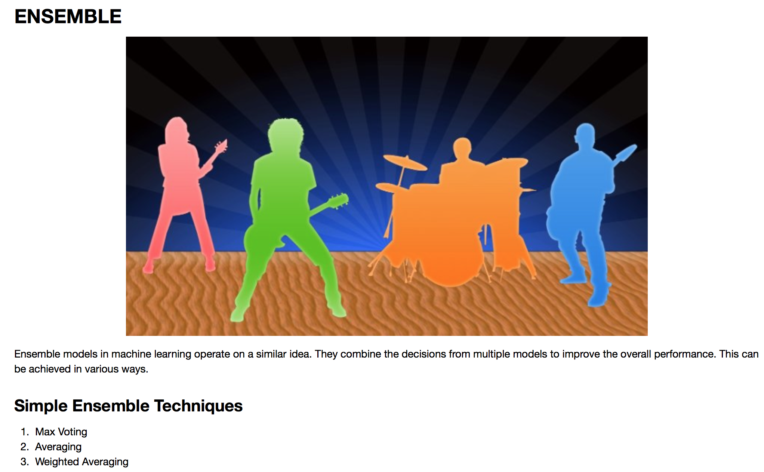

Slide 15
